Slide 1
CS 366 Intro to Cybersecurity
Dr. Stella Sun
EECS
University of Tennessee
Fall 2022

Slide 2
Today’s Class
Web security
- SQL injection and defense

Slide 3
Time to Switch Hats – Defenses

Slide 4
Mitigation of SQL Injection
Understand the code and identify where to put defense
Defense in depth

Slide 5
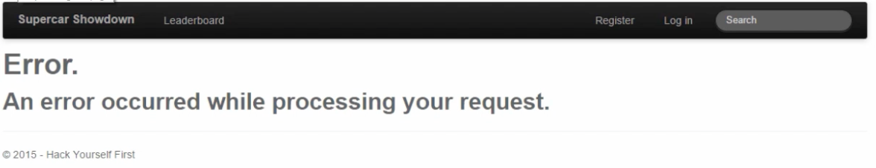
Defense: Proper Error Handling
Turn on customErrors mode in Web.config
It will become:

Slide 6
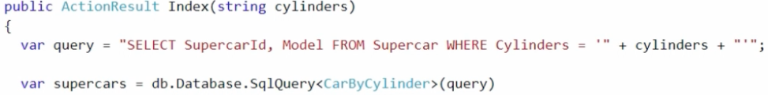
Defense: Validating Untrusted Data
Code segment from CarsByCylindersController in the web app

Slide 7
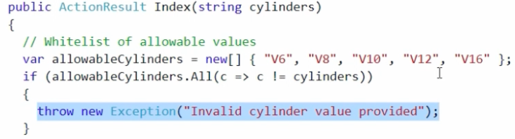
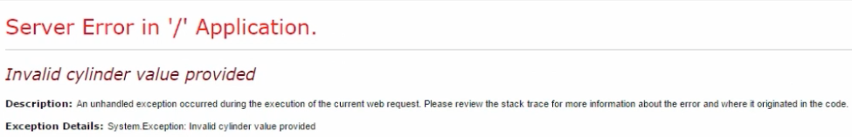
Defense: Validating Untrusted Data
Add a whitelist
Now if we do:
hack-yourself-first.com/CarsByCylinders?Cylinders=V12’

Slide 8
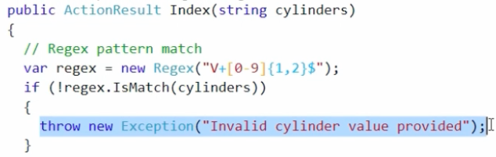
Defense: Validating Untrusted Data
Problem with this whitelist:
- Too specific, what if V5 is later added
A better whitelist:
- Looking for patterns

Slide 9
Defense: Validating Untrusted Data
Now the page with V5 as the query data looks like:
No error anymore, although currently no content under V5
But what if we later add something like Flat 6?

Slide 10
Whitelisting vs. Blacklisting
Whitelisting: only allow what’s known to be good
Blacklisting: disallow what’s known to be bad
- It looks for malicious patterns, e.g., attack signatures such as ’ or 1=1--
- Attacker can change the patterns to evade detection

Slide 11
Evading Pattern Matching: Basic Idea
We know ’ or 1=1-- is bad
What about
- ’ or ‘foo’=‘foo’--
- ’ or 5>3--
- ’ or ‘foo’>‘f’--
These are also always true!
It often takes trial and error to find out what syntax is accepted

Slide 12
Evading Pattern Matching: Encoding
Signatures may look for specific characters
Can use encoding to bypass it
- URL encoding
- Hex
- Unicode
- SQL’s char()

Slide 13
Evading Pattern Matching: String Splitting
Signatures may look for exact string match
Can split the attack string to bypass it
Example:
’; exec (‘sel’ + ‘ect password fr’ + ‘om UserProfile’)--

Slide 14
Evading Pattern Matching: White Space Diversity
Signatures may look for multiple words together
Example: union select
What pattern between words to look for?
- one space?
- multiple spaces?
- tab?
- line returns?
- …

Slide 15
Evading Pattern Matching: Inline Comments
’/**/ or/**/ 1/**/=/**/1--
Across parameters:
Username: alice’ or 1/*
Password: */=1--
The database sees:
select * from user where Username=‘alice’ or 1/*and Password=‘*/=1--’

Slide 16
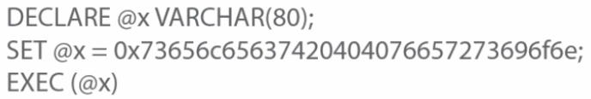
Evading Pattern Matching: Variables
Variables can break the statement up
Assigning a hex value to a variable can avoid the use of quotes
Example: a pattern like select @@version is common
But this is far less common (using both variables and encoding):

Slide 17
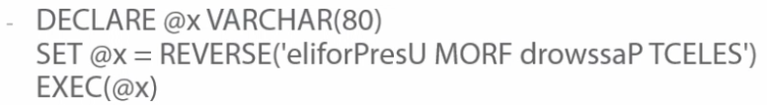
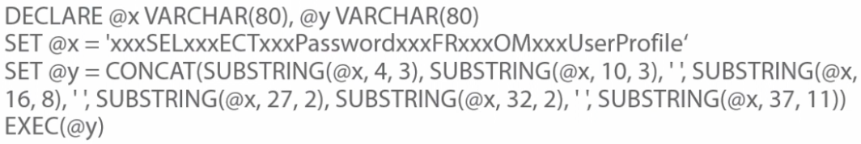
Evading Pattern Matching: String Manipulation
Different ways of transforming and restoring malicious strings
- Reversing
- Obfuscating

Slide 18
Whitelisting or Blacklisting?

Slide 19
Defense: Query Parameterization
Also called prepared statement
Fundamental cause of SQL injection: mixing data and code
Solution: separate data and code
Main idea: send code and data in separate channels to the database server

Slide 20
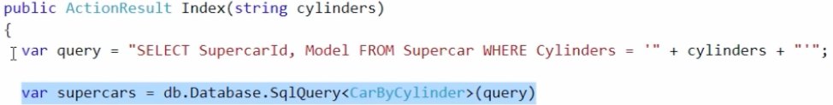
Defense: Query Parameterization
Let’s check out the following code segment from the web app again:
Root problem: web app prepares the SQL statement (2nd line) which gets executed (3rd line)
- web app combines query structure with untrusted data
- untrusted data can break out the data context and get executed as part of the query structure

Slide 21

Defense: Query Parameterization
This is what the database server sees when V12 is passed as query data

Slide 22

Defense: Query Parameterization
With an injection shown before:
hack-yourself-first.com/CarsByCylinders?Cylinders=V12’ or 1=1--
The database server sees
- data bleeds into the query structure
Solution: parameterize the query data so that untrusted data is not mixed in to change the logic

Slide 23
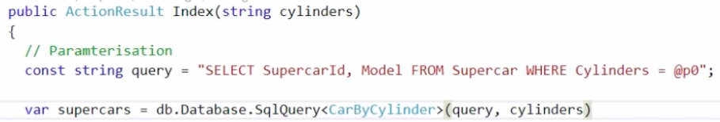
Defense: Query Parameterization
Example solution:
Now the database server sees two things:
SELECT SupercarID, Model FROM Supercar WHERE Cylinders = @p0
@p0=‘V12’’ or 1=1--’

Slide 24
Other Defense Techniques
The defense techniques we’ve seen so far focuses on good web app coding practice
Other defense techniques
- from the DB, principle of least privilege
- using firewall
- using WAF

Slide 25
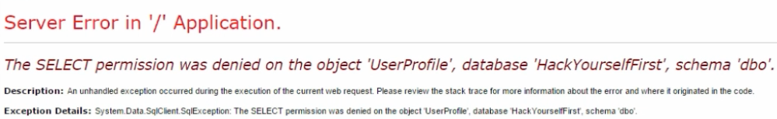
Defense: Principle of Least Privilege
Web app often gets way more access rights than necessary
Example: disable SELECT permission on UserProfile table in SQL server management studio for public
Then, a union-based injection that was successful before now fails:
hack-yourself-first.-com/CarsByCylinders?Cylinders=V12’ union select UserID,Password from UserProfile--

Slide 26
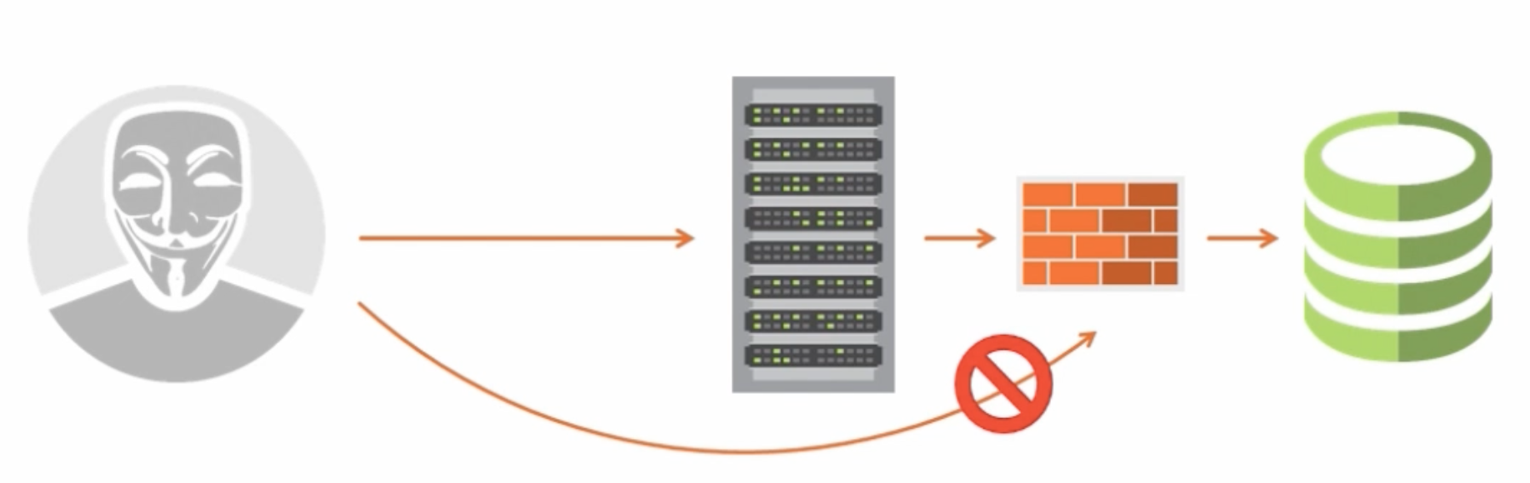
Isolating the Database Network
Can leverage the firewall to do filtering
Not really specifically for SQL injection

Slide 27
Defense: Using IDS or WAF
Intrusion detection system (IDS) or web application firewall (WAF) sits in front of the web server, e.g., CloudFlare, Barracuda
They can be maintained independently of the web app and updated to mitigate emerging risks
They are generally signature-based: looking for malicious patterns

Slide 28
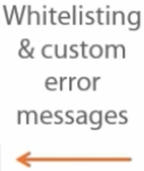
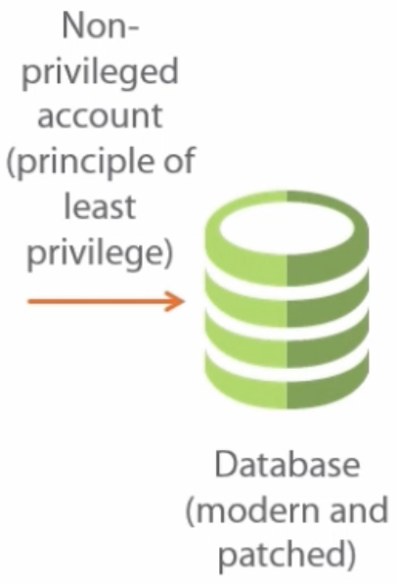

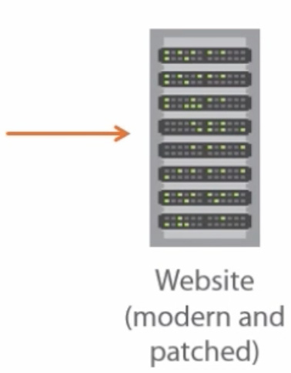
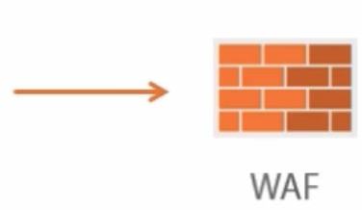
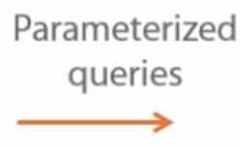

Putting It Together: Defense in Depth

